Slide 1
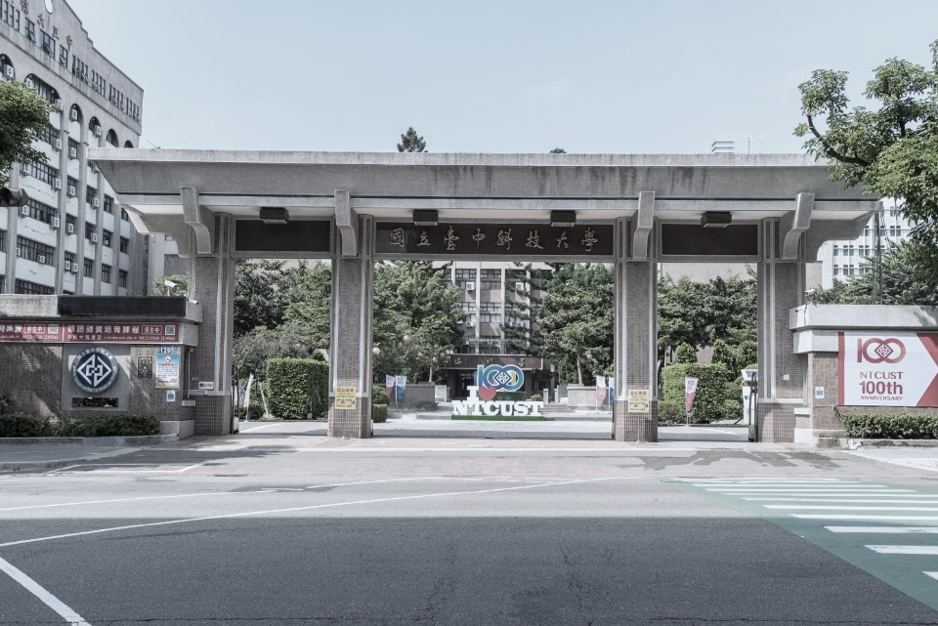
Stock Prediction Based on Deep Neural Network Combining Mixed Frequency Financial Data and Monthly Revenue
碩士學位考試
口試學生 : 林毓翔
口試委員 : 國立中興大學 劉宗榮教授
國立中山大學 楊惠芳教授
國立臺中科技大學 劉冠顯教授
日期 : 2024年12月13日 16:00
地點 : 弘業樓4樓6402室

Slide 2
Outline
Introduction
Related Work
Method
Datasets
Experiments
Conclusion
References

Slide 3
Introduction

Slide 4
Introduction(1/6)
What is Stock prediction?
Stock prediction is forecasting future stock prices based on historical data.
Stock prediction
a popular topic within financial research
attracting diverse methodologies
Various methods
forecast stock price trends
devise effective trading strategies

Slide 5
Introduction(2/6)
Ball et al [1]
Found that there is a correlation between stock price and accounting information.
Investors can obtain excess profits from company stocks achieving high prediction accuracy.
Chen et al. [2]
Study the relationship between financial ratios and stock prices
The biggest factor affecting the stock price is the cash flow ratio.

Slide 6
Introduction(3/6)
Aadhitya et al.[3]
Long Short-Term Memory (LSTM) for stock prediction
achieving high prediction accuracy with minimal errors.
Kryzanowski et al.[4]
Neural networks combining financial ratios and macroeconomic factors
Achieve an accuracy of 72% in classifying the positive and negative returns of stock prices within a year.

Slide 7
Introduction(4/6)
Das et al. [5]
Transforemer model to predict the stock prices of IBM, APPLE and TATAMOTORS.
Achieve smaller prediction errors.
Lin et al.[6]
Used the WGAN-GP model to predict the Nasdaq Composite Index (NASDAQ) , New York Stock Exchange Composite Index (NYSE)…
The prediction effect is better than that of LSTM, GRU and GAN models.

Slide 8
Introduction(5/6)
Aadhitya et al. [7]
CNN_LSTM Neural Network mode for stock prediction
Achieving great performance
WANG et al. [20]
Proposed Transformer-TCN model for stock prediction
Better prediction results than other hybrid models in Shanghai and Shenzhen stock markets.

Slide 9
Introduction(6/6)
We proposed a improved framework based on the Transformer model.
Attention mechanism for boosting performance
The proposed framework is validated on various dataset,specifically in our cross-frequency dataset.
A cross-frequency dataset quarterly financial ratios and monthly revenue data

Slide 10
Related Work

Slide 11
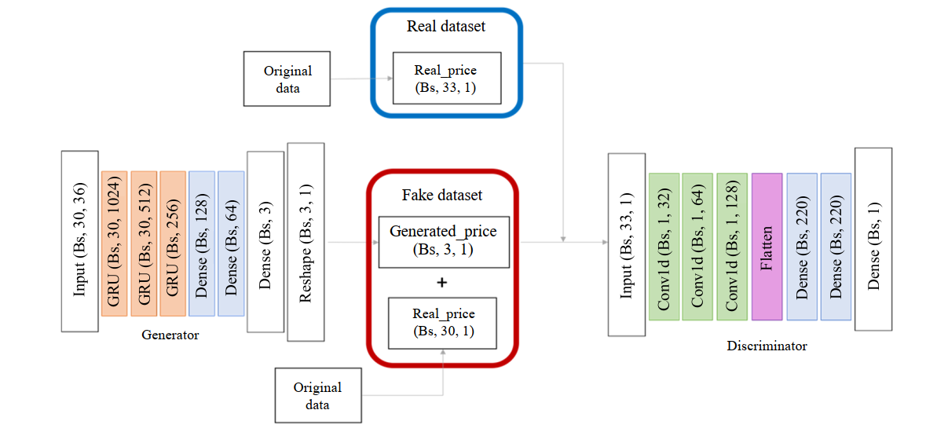
Related Work(1/7)
Stock price prediction using Generative Adversarial Networks [8]

Slide 12
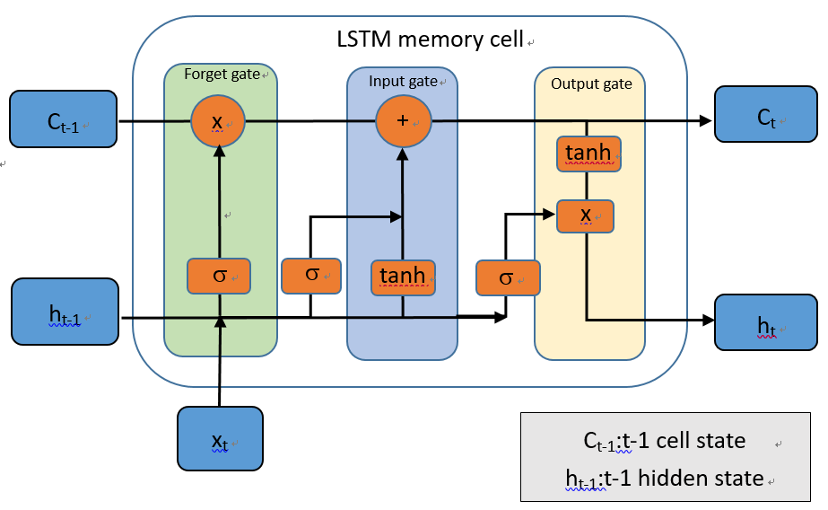
Related Work(2/7)
Predicting Stock Market time-series data using CNN-LSTM Neural Network model[4]

Slide 13
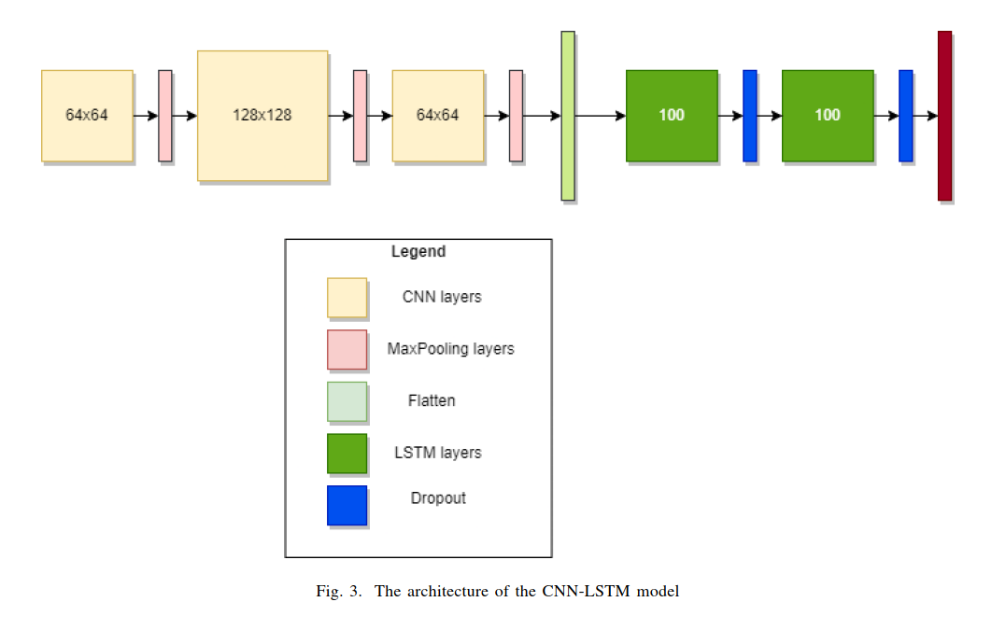
Related Work(3/7)
Predicting Stock Market time-series data using CNN-LSTM Neural Network model[4]

Slide 14
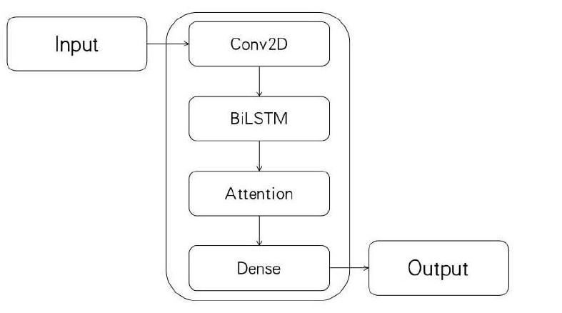
Related Work(4/7)
Stock Price Prediction Using CNN-BiLSTM-Attention Model

Slide 15
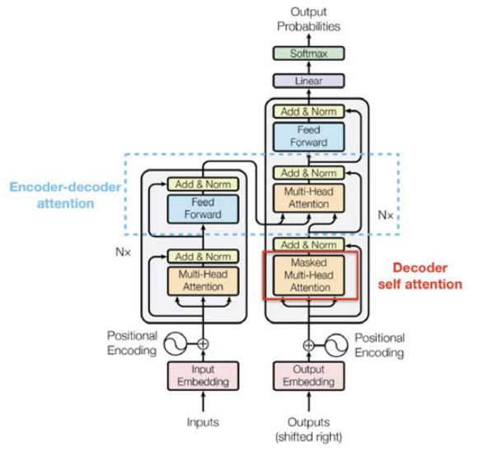
Related Work(5/7)
Stock_Price_Prediction_Using_Time_Embedding_and_Attention_Mechanism_in_Transformers[7]

Slide 16
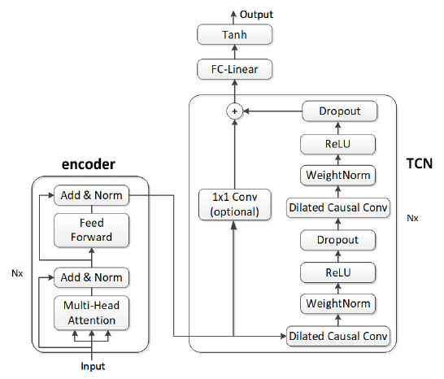
Related Work(6/7)
A_Stock_Price_Prediction_Method_Based_on_BiLSTM_and_Improved_Transformer[7]

Slide 17
Related Work(7/7)
[9] A. Fauzan, M. SusanAnggreainy, N. Nathaniel, and A. Kurniawan, “Predicting stock market movements using long short-term memory (lstm),”

Slide 18
Method

Slide 19
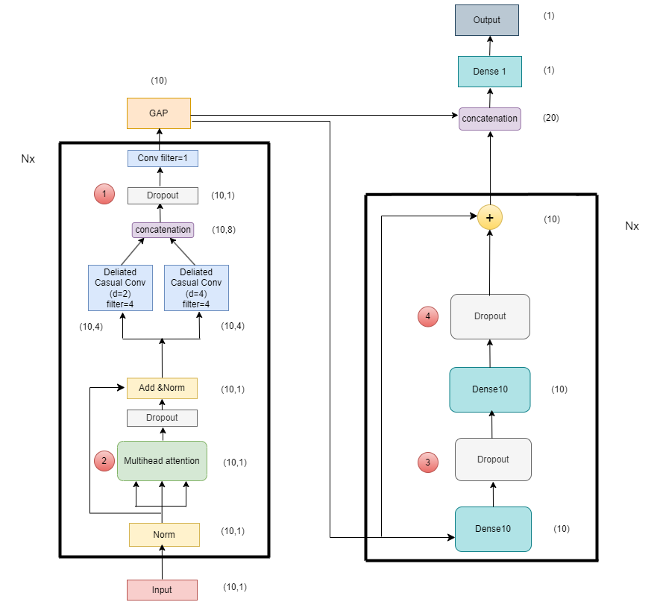
Method(1/13)
The overall architecture of proposed model
for AAPL, TSLA, MSFT, IBM

Slide 20
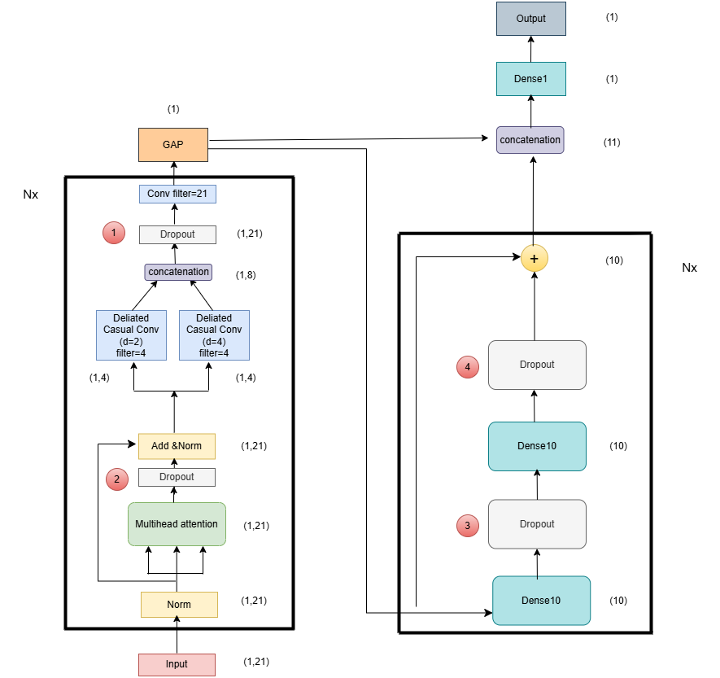
Method(2/13)
The overall architecture of proposed model
for StockQM

Slide 21
Method(3/13)
The overall architecture of proposed model
月份 | 季財務資料 | 月財務資料 | 預測股價 | 符號表示
5 | 5/15前公布第一季財報(1~3月) | 6/10公布5月營收 | 6/30股價 | T
6 | 5/15前公布第一季財報(1~3月) | 7/10公布6月營收 | 7/31股價 | T-1
7 | 5/15前公布第一季財報(1~3月) | 8/10公布7月營收 | 8/31股價 | T-2
8 | 8/14前公布第二季財報(4~6月) | 9/10公布8月營收 | 9/30股價 | T
9 | 8/14前公布第二季財報(4~6月) | 10/10公布9月營收 | 10/31股價 | T-1
10 | 8/14前公布第二季財報(4~6月) | 11/10公布10月營收 | 11/30股價 | T-2
11 | 11/14前公布第三季財報(7~9月) | 12/10公布11月營收 | 12/31股價 | T
12 | 11/14前公布第三季財報(7~9月) | 1/10公布12月營收 | 1/31股價 | T-1
1 | 11/14前公布第三季財報(7~9月) | 2/10公布1月營收 | 2/28股價 | T-2
2 | 11/14前公布第三季財報(7~9月) | 3/10公布2月營收 | 3/31股價 | T-3
3 | 3/31前公布第四季財報(10~12月) | 4/10公布3月營收 | 4/30股價 | T
4 | 3/31前公布第四季財報(10~12月) | 5/10公布4月營收 | 5/31股價 | T-1

Slide 22
Method(4/13)
Model parameter
Dataset | Total params | Flops | Training Time
AAPL | 4889 | 20625 | 15min
TSLA | 7055 | 17389 | 16min
MSFT | 6333 | 3934 | 17min
IBM | 8437 | 9172 | 12min
StockQM | 59932 | 135057 | 15min

Slide 23
Method(5/13)
18 quarterly Financial indicators(Solvency)
Debt Ratio
Long Term Debt To Total Assets Ratio
Current Ratio
Quick Ratio
Interest Coverage Ratio

Slide 24
Method(6/13)
18 quarterly Financial indicators(Operational Ability)
Accounts Receivable Turnover Ratio
Average Collection Days
Inventory Turnover
Days Sales Of Inventory
Asset Turnover Ratio

Slide 25
Method(7/13)
18 quarterly Financial indicators(Profitability)
Gross Profit Margin
Operating Profit Margin
Net Income Margin
ROA
ROE

Slide 26
Method(8/13)
18 quarterly Financial indicators(Cash Flow)
Operating Cash To Current Liabilities Ratio
Operating Cash To Liabilities Ratio
Operating Cash To Net Earnings After Tax Ratio
ROA
ROE

Slide 27
Method(9/13)
3 monthly Financial indicators
Month on Month
Year On Year
Quarter on Quarter

Slide 28
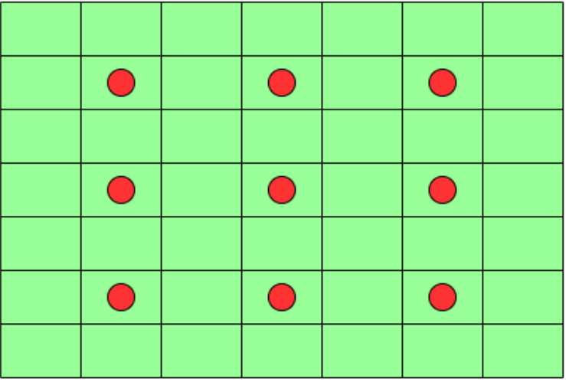
Method(10/13)
Dilation CONV1D

Slide 29
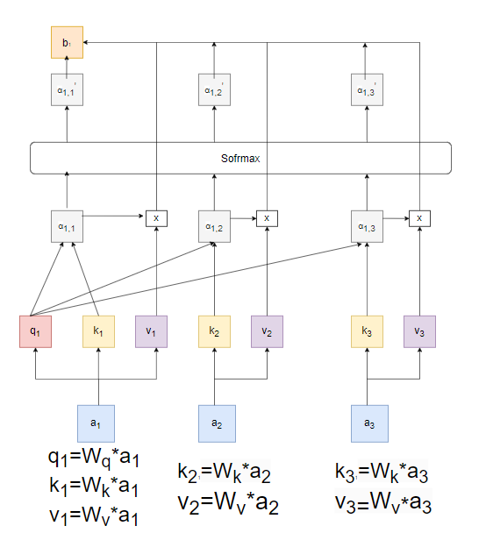

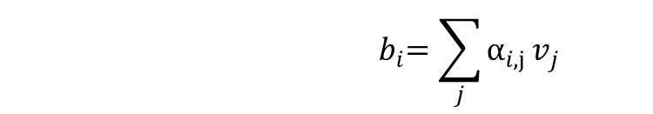
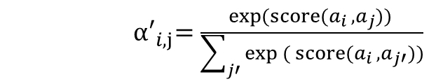
Method(11/13)
Self Attention(1)
score($a_{i}$ , $a_{j}$) = tanh($W_{q}a_{i}$ + $W_{k}a_{j}$)
${ α′}_{i,j}=\frac{\exp{(score(a_{i} , a_{j})}) }{\sum_{j′}{\exp{({score(a_{i} , a_{j′})}})}}$
$${ b}_{i}=\sum_{j}{α_{i,j}}v_{j}$$

Slide 30
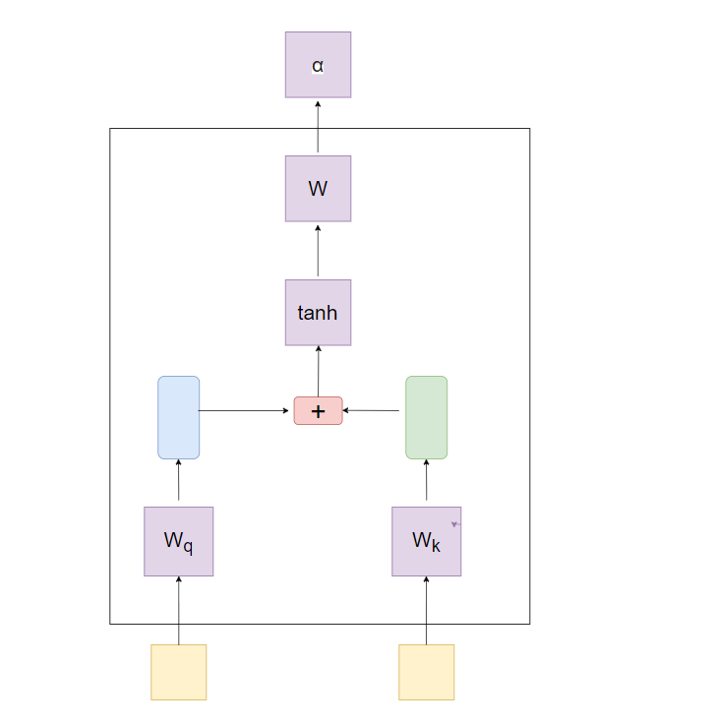
Related Work(12/13)
Self Attention(2)

Slide 31
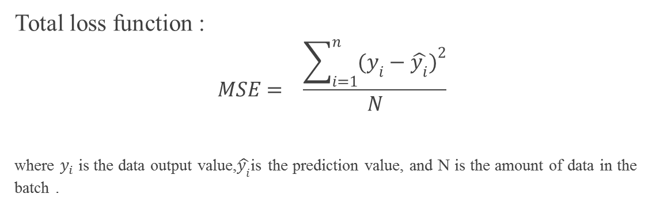
Method(13/13)
Total loss function :
$$MSE= \frac{\sum_{i=1}^{n}{(y_{i}−{\hat{y_{i}})}^{2}}}{N}$$
where $y_{i}$is the data output value,$\hat{y_{i}}$is the prediction value, and N is the amount of data in the batch .

Slide 32
Datasets

Slide 33
Datasets(1/3)
stock
data period
Four company stock
Select daily stock prices of TSLA, MSFT, IBM, and APPL in Yahoo Finance
AAPL data period is 1980/12/12~2024/7/31, Select 6598 data as training data and 2200 data as validation data and 2200 data as test data.
TSLA data period is 2010/6/29~2024/7/31, Select 2127 data as training data and 709 data as validation data and 709 data as test data.

Slide 34
Datasets(2/3)
stock
data period
Four company stock
MSFT data period is 1986/3/13~2024/7/31, Select 5803 data as training data and 1934 data as validation data and 1934 data as test data.
IBM data period is 1980/1/1~2024/7/31, Select 6742 data as training data and 2248 data as validation data and 2248 data as test data.

Slide 35
Datasets(3/3)
stock
StockQM
Includes 18 quarterly financial indicators and 3 monthly revenue indicators which are provided by the Public Information Observatory.
405 companies spans 44 quarter total 132 months months from May 2013 to May 2024, with incomplete data points removed.
The target variable, representing the stock price at the end of the next month after the stock quarterly earnings report is released.
32,076 data for training and 10,692 data for validation,10,692 for testing.

Slide 36
Experiments

Slide 37
Experiments(1/42)
Implementation environment :
CPU：Intel Xeon 2800G
GPU：NVIDIA GeForce RTX 2080 Ti
RAM：128GB
Development Framework：Tensorflow、Keras
Programming Language：Python3.7

Slide 38
Experiments(2/42)
Ablation study of mymodel on AAPL, TSLA, MSFT, IBM

Slide 39
Experiments(3/42)
Ablation study of mymodel on mydata

Slide 40
Experiments(4/42)
Compare the impact of dropout ratios
MAE
Dataset | dropout10% | dropout 15% | dropout 20% | dropout 25% | dropout 30% | No dropout
AAPL | 15.52 | 22.09 | 28.93 | 14.74 | 49.82 | 30.01
TSLA | 186.79 | 242.69 | 98.32 | 35.38 | 105.37 | 419.98
MSFT | 43.25 | 69.96 | 11.67 | 7.46 | 12.82 | 123.57
IBM | 4.08 | 2.76 | 3.89 | 2.51 | 2.83 | 34.52
StockQM | 32.33 | 43.54 | 29.37 | 31.74 | 33.19 | 38.07

Slide 41
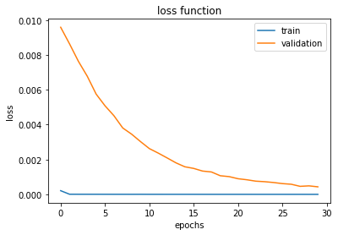
Experiments(5/42)
AAPL dropout 25% loss function

Slide 42
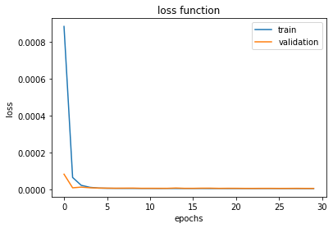
Experiments(6/42)
MSFT dropout 25% loss function

Slide 43
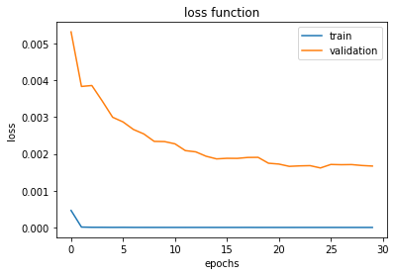
Experiments(7/42)
TSLA dropout 25% loss function

Slide 44
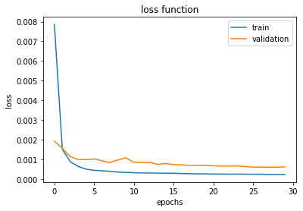
Experiments(8/42)
IBM dropout 25% loss function

Slide 45
Experiments(9/42)
StockQM dropout 25% loss function

Slide 46
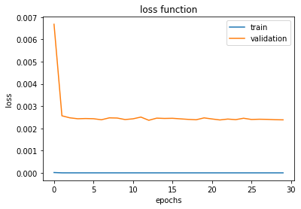
Experiments(10/42)
AAPL nodropout loss function

Slide 47
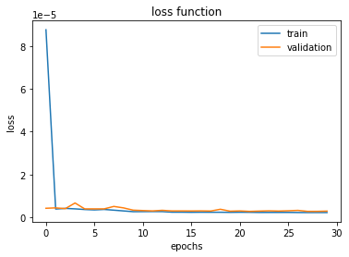
Experiments(11/42)
MSFT nodropout loss function

Slide 48
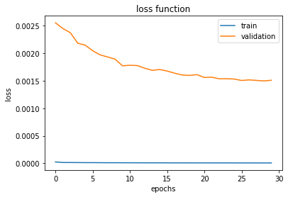
Experiments(12/42)
TSLA nodropout loss function

Slide 49
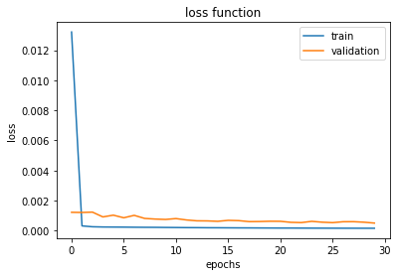
Experiments(13/42)
IBM nodropout loss function

Slide 50
Experiments(14/42)
StockQM nodropout loss function

Slide 51
Experiments(15/42)
Comparing the impact of dropping out of school
Dataset | MAE
 | dropout1個(1) | dropout1個(2) | dropout1個(3) | dropout1個(4) | dropout2個(12) | dropout2個(13) | dropout2個(14) | dropout2個(34)
AAPL | 96.63 | 96.41 | 125.71 | 45.9 | 177.55 | 192.3 | 96.41 | 24.7
TSLA | 309.25 | 237.7 | 125.02 | 45.3 | 215.6 | 237.7 | 2.54 | 32.3
MSFT | 32.68 | 209.11 | 209.11 | 34.17 | 25.63 | 24.04 | 35.92 | 16.85
IBM | 128.45 | 128.45 | 128.45 | 2.6 | 62.57 | 67.53 | 4.63 | 2.87
StockQM | 29.87 | 28.82 | 31.67 | 36.41 | 30.03 | 30.71 | 33.59 | 37.37

Slide 52
Experiments(16/42)
Comparing the impact of dropping out of school
資 料 集 | MAE
 | dropout1個(1) | dropout1個(2) | dropout1個(3) | dropout1個(4) | dropout2個(12) | dropout2個(13) | dropout2個(14) | dropout2個(34)
AAPL | 96.63 | 96.41 | 125.71 | 45.9 | 177.55 | 192.3 | 96.41 | 24.7
TSLA | 309.25 | 237.7 | 125.02 | 45.3 | 215.6 | 237.7 | 2.54 | 32.3
MSFT | 32.68 | 209.11 | 209.11 | 34.17 | 25.63 | 24.04 | 35.92 | 16.85
IBM | 128.45 | 128.45 | 128.45 | 2.6 | 62.57 | 67.53 | 4.63 | 2.87
StockQM | 29.87 | 28.82 | 31.67 | 36.41 | 30.03 | 30.71 | 33.59 | 37.37

Slide 53
Experiments(17/42)
Compare the impact of different numbers of encoders and decoders
(AAPL)
encoder/decoder number | 0 | 1 | 2 | 3 | 4 | 5 | 6 | 7 | 8 | 9
0 | 52.85 | 53.34 | 132.95 | 125.52 | 42.26 | 36.46 | 137.66 | 91.97 | 191.19 | 200.74
1 | 6.13 | 28.93 | 38.01 | 48.37 | 154.71 | 11.28 | 43.62 | 21.51 | 162.68 | 402.89
2 | 12.11 | 11.48 | 84.26 | 17.22 | 141.35 | 141.69 | 185.26 | 42.73 | 159.68 | 233.28
3 | 2.86 | 3.23 | 40.79 | 14.22 | 197.22 | 409.27 | 68.95 | 58.77 | 165.68 | 307.32
4 | 81.05 | 5.86 | 89.19 | 61.88 | 46.31 | 2.62 | 449.56 | 819.89 | 152.68 | 337.35
5 | 116.28 | 152.09 | 85.82 | 25.22 | 44.94 | 407.98 | 553.42 | 511.91 | 141.68 | 131.31
6 | 172.72 | 15.75 | 8.63 | 177.44 | 164.33 | 257.29 | 158.58 | 165.28 | 125.68 | 114.66
7 | 2.96 | 140.04 | 192.08 | 158.62 | 173.17 | 36.98 | 57.37 | 542.55 | 136.68 | 480.09
8 | 73.75 | 150.27 | 17.23 | 94.67 | 167.02 | 145.42 | 298.47 | 415.04 | 139.68 | 176.82
9 | 67.83 | 371.15 | 6.92 | 59.15 | 44.02 | 438.98 | 266.83 | 172.58 | 118.68 | 26.52

Slide 54
Experiments(18/42)
Compare the impact of different numbers of encoders and decoders
(TSLA)
encoder/decoder number | 0 | 1 | 2 | 3 | 4 | 5 | 6 | 7 | 8 | 9
0 | 25.45 | 87.14 | 18.44 | 59.96 | 139.54 | 17.31 | 76.79 | 208.61 | 287.04 | 140.07
1 | 30.91 | 35.38 | 55.25 | 28.88 | 297.71 | 370.18 | 105.69 | 490.99 | 493.24 | 321.88
2 | 18.87 | 19.38 | 27.39 | 356.11 | 40.08 | 489.16 | 279.73 | 257.32 | 873.27 | 195.77
3 | 16.04 | 31.88 | 124.48 | 112.62 | 985.69 | 147.95 | 255.44 | 647.96 | 1444.73 | 378.12
4 | 25.25 | 35.88 | 50.78 | 80.76 | 95.31 | 117.36 | 54.62 | 791.38 | 327.04 | 441.93
5 | 17.53 | 150.04 | 71.85 | 125.16 | 102.45 | 108.67 | 107.41 | 506.88 | 434.09 | 794.54
6 | 19.62 | 73.33 | 122.04 | 257.59 | 160.67 | 697.99 | 648.75 | 393.97 | 460.84 | 173.53
7 | 16.67 | 50.53 | 16.34 | 439.22 | 197.61 | 73.02 | 50.52 | 879.5 | 412.34 | 254.78
8 | 36.67 | 93.66 | 47.51 | 53.61 | 268.85 | 269.94 | 960.04 | 175.98 | 358.79 | 759.61
9 | 17.07 | 64.15 | 473.65 | 88.82 | 322.66 | 523.46 | 378.84 | 105.71 | 169.72 | 341.11

Slide 55
Experiments(18/42)
Compare the impact of different numbers of encoders and decoders
(MSFT)
encoder/decoder number | 0 | 1 | 2 | 3 | 4 | 5 | 6 | 7 | 8 | 9
0 | 6.93 | 34.67 | 7.55 | 50.83 | 44.86 | 133.38 | 35.26 | 38.63 | 151.24 | 259.8
1 | 8.25 | 7.46 | 7.16 | 68.09 | 190.65 | 17.92 | 15.58 | 184.15 | 38.47 | 129.39
2 | 7.23 | 27.89 | 16.76 | 77.08 | 99.06 | 32.17 | 216.36 | 762.89 | 138.52 | 216.66
3 | 7.22 | 18.24 | 57.99 | 122.08 | 6.33 | 22.96 | 84.92 | 50.75 | 226.68 | 41.14
4 | 7.58 | 60.48 | 13.23 | 21.95 | 65.17 | 9.88 | 49.83 | 173.06 | 169.35 | 109.16
5 | 7.63 | 60.43 | 72.67 | 24.48 | 138.83 | 296.38 | 142.62 | 477.17 | 38.82 | 21.86
6 | 9.96 | 38.16 | 19.31 | 5.24 | 18.12 | 246.99 | 109.58 | 114.14 | 275.71 | 646.28
7 | 6.77 | 11.23 | 17.16 | 33.8 | 12.36 | 33.29 | 64.4 | 274.28 | 33.82 | 373.52
8 | 6.15 | 11.74 | 16.27 | 57.01 | 60.23 | 126.6 | 280.5 | 60.77 | 1131.42 | 66.17
9 | 6.09 | 6.43 | 37.75 | 69.21 | 159.25 | 217.44 | 104.62 | 244.57 | 148.85 | 112.68

Slide 56
Experiments(19/42)
Compare the impact of different numbers of encoders and decoders
(IBM)
encoder/decoder number | 0 | 1 | 2 | 3 | 4 | 5 | 6 | 7 | 8 | 9
0 | 3.53 | 4.51 | 4.47 | 3.55 | 7.36 | 13.74 | 3.51 | 18.09 | 4.74 | 19.35
1 | 2.54 | 2.51 | 2.69 | 2.98 | 7.28 | 3.05 | 8.57 | 9.67 | 5.92 | 40.23
2 | 2.55 | 4.06 | 3.37 | 3.86 | 4.88 | 12.09 | 3.48 | 2.7 | 23.65 | 12.41
3 | 3.76 | 3.62 | 6.16 | 8.95 | 2.97 | 2.81 | 6.16 | 3.79 | 3.98 | 4.96
4 | 2.44 | 3.21 | 3.48 | 3.93 | 7.69 | 4.49 | 5.92 | 4.06 | 2.94 | 6.92
5 | 3.99 | 2.49 | 3.68 | 3.19 | 2.41 | 5.94 | 12.69 | 3.21 | 4.14 | 15.74
6 | 5.71 | 4.75 | 2.73 | 3.91 | 3.73 | 8.55 | 8.18 | 3.99 | 56.52 | 5.95
7 | 5.05 | 6.82 | 5.48 | 3.05 | 3.74 | 9.77 | 17.97 | 7.32 | 4.16 | 6.95
8 | 3.62 | 5.58 | 3.27 | 4.33 | 2.33 | 11.22 | 7.15 | 4.18 | 10.31 | 43.45
9 | 3.98 | 2.67 | 3.25 | 2.71 | 2.42 | 6.25 | 4.93 | 5.56 | 30.34 | 62.87

Slide 57
Experiments(20/42)
Compare the impact of different numbers of encoders and decoders
(Mydata)
encoder/decoder number | 0 | 1 | 2 | 3 | 4 | 5 | 6 | 7 | 8 | 9
0 | 35.98 | 31.11 | 33.49 | 35.66 | 32.93 | 35.36 | 30.76 | 30.06 | 29.45 | 30.43
1 | 31.76 | 31.74 | 36.18 | 34.79 | 38.07 | 33.28 | 30.71 | 35.52 | 36.45 | 29.37
2 | 36.72 | 38.73 | 41.11 | 28.68 | 38.31 | 36.32 | 31.31 | 32.27 | 33.05 | 31.51
3 | 36.97 | 33.67 | 31.82 | 31.93 | 31.61 | 27.86 | 35.04 | 31.55 | 32.01 | 36.48
4 | 34.83 | 29.26 | 30.61 | 29.62 | 32.81 | 33.62 | 31.43 | 34.01 | 39.93 | 39.86
5 | 36.84 | 32.01 | 33.59 | 33.66 | 31.9 | 31.17 | 30.26 | 42.67 | 43.06 | 28.11
6 | 42.36 | 35.18 | 32.36 | 32.26 | 29.98 | 31.26 | 37.21 | 30.57 | 41.36 | 33.81
7 | 33.56 | 30.24 | 36.99 | 32.97 | 32.24 | 34.89 | 33.92 | 29.28 | 31.13 | 34.28
8 | 29.78 | 32.4 | 34.96 | 31.88 | 31.22 | 33.52 | 34.09 | 89.27 | 31.95 | 28.32
9 | 29.53 | 32.14 | 30.99 | 33.68 | 30.72 | 32.76 | 36.98 | 31.47 | 32.58 | 32.34

Slide 58
Experiments(21/42)
Compare the impact of different activation functions
MAE
Dataset | relu | tanh | sigmoid | encoder number | decoder number
AAPL | 2.62 | 68.25 | 93.96 | 4 | 5
TSLA | 16.34 | 13.35 | 257.77 | 7 | 2
MSFT | 5.24 | 9.18 | 175.93 | 6 | 3
IBM | 2.33 | 5.74 | 45.92 | 8 | 4
StockQM | 28.11 | 28.95 | 30.05 | 5 | 9

Slide 59
Experiments(22/42)
Compare the impact of adding decoder
MAE
Dataset | Without decoder | Adding decoder | Encoder number | Decoder number
AAPL | 96.38 | 2.62 | 4 | 5
TSLA | 222.29 | 16.34 | 7 | 2
MSFT | 86.53 | 5.24 | 6 | 3
IBM | 15.32 | 2.33 | 8 | 4
StockQM | 30.37 | 28.11 | 5 | 9

Slide 60
Experiments(23/42)
Compare the impact of adding decoder
MAE
Dataset | Without decoder | Adding decoder | Encoder number | Decoder number
AAPL | 96.38 | 2.62 | 4 | 5
TSLA | 222.29 | 16.34 | 7 | 2
MSFT | 86.53 | 5.24 | 6 | 3
IBM | 15.32 | 2.33 | 8 | 4
StockQM | 30.37 | 28.11 | 5 | 9

Slide 61
Experiments(24/42)
Compare the impact of whether the output layer adds an activation function
MAE
Dataset | Output layer add relu | Output layer without relu
AAPL | 25.31 | 2.62
TSLA | 29.53 | 16.34
MSFT | 4.43 | 5.24
IBM | 3.72 | 2.33
StockQM | 39.26 | 28.11

Slide 62
Experiments(25/42)
Compare the impact of different time_steps
MAE
Dataset | Timestep 5 days | Timestep 10 days | Timestep 15 days | Timestep 20 days | Timestep 25 days | encoder number | decoder number
AAPL | 48.18 | 2.62 | 72.94 | 6.76 | 106.67 | 4 | 5
TSLA | 69.53 | 16.34 | 120.35 | 55.43 | 37.14 | 7 | 2
MSFT | 95.98 | 5.24 | 6.42 | 15.26 | 34.82 | 6 | 3
IBM | 5.15 | 2.33 | 2.88 | 5.46 | 2.76 | 8 | 4

Slide 63
Experiments(26/42)
Compare the impact of financial information
Dataset | 10 days MAE | With financial data MAE
StockQM | 28.65 | 26.51

Slide 64
Experiments(27/427)
Compare the impact of quarterly earnings release month
Symbol | T | T-1 | T-2 | T-3
MAE | 27.04 | 28.38 | 28.41 | 28.81

Slide 65
Experiments(28/42)
Compare the impact of the number of encoders and decoders
on the Transformer model(AAPL)
encoder/decoder number | 0 | 1 | 2 | 3 | 4 | 5 | 6 | 7 | 8 | 9
0 | 8.85 | 9.79 | 5.73 | 12.08 | 83.1 | 65.4 | 169.7 | 142.03 | 67.75 | 35.86
1 | 9.16 | 17.61 | 5.66 | 15.04 | 68.56 | 38.63 | 20.24 | 15.17 | 66.99 | 224.4
2 | 9.33 | 53.21 | 8.57 | 29.6 | 38.34 | 126.49 | 54.37 | 145 | 198.91 | 24.43
3 | 168.61 | 39.95 | 60.84 | 22.68 | 14.98 | 47.84 | 71.19 | 16.36 | 131.28 | 106.64
4 | 168.71 | 40.83 | 31.39 | 8.69 | 168.17 | 192.65 | 26.49 | 39.51 | 133.23 | 119.57
5 | 12.76 | 151.77 | 131.47 | 88.2 | 114.34 | 47.93 | 21.18 | 127.97 | 9.36 | 87.52
6 | 99.87 | 55.38 | 206.49 | 87.9 | 164.61 | 53.96 | 73.84 | 52.98 | 156.54 | 11.87
7 | 7.26 | 11.56 | 100.29 | 61.86 | 341.46 | 45.04 | 169.73 | 32.76 | 164.25 | 62.34
8 | 122.21 | 184.46 | 14.85 | 139.59 | 28.79 | 159.73 | 209.13 | 44.11 | 146.43 | 180.78
9 | 8.98 | 22.99 | 135.11 | 262.47 | 31.32 | 45.77 | 74.82 | 123.15 | 40.72 | 65.81

Slide 66
Experiments(29/42)
Compare the impact of the number of encoders and decoders
on the Transformer model(TSLA)
encoder/decoder number | 0 | 1 | 2 | 3 | 4 | 5 | 6 | 7 | 8 | 9
0 | 378.51 | 30.52 | 27.04 | 19.83 | 53.63 | 18.26 | 249.46 | 127.52 | 66.79 | 32.97
1 | 260.81 | 51.59 | 20.15 | 15.39 | 40.4 | 145.24 | 114.21 | 26.45 | 23.29 | 414.53
2 | 27.12 | 24.09 | 19.04 | 25.52 | 21.2 | 94.13 | 122.56 | 254.13 | 53.82 | 63.04
3 | 22.63 | 22.92 | 28.38 | 18.03 | 17.56 | 97.05 | 29.05 | 130.85 | 95.78 | 45.18
4 | 30.26 | 56.49 | 19.91 | 41.38 | 121.4 | 189.74 | 216.42 | 173.83 | 439.89 | 170.13
5 | 21.16 | 26.34 | 200.19 | 102.6 | 23.72 | 22.27 | 97.83 | 43.61 | 172.25 | 57.99
6 | 28.53 | 20.13 | 438.54 | 25.87 | 196.6 | 33.92 | 108.34 | 77.43 | 68.54 | 136.61
7 | 236.88 | 52.13 | 98.35 | 33.71 | 176 | 184.26 | 18.36 | 53.07 | 55.31 | 18.28
8 | 40.05 | 111.56 | 58.87 | 28.88 | 41.22 | 71.73 | 60.98 | 227.21 | 27.99 | 136.83
9 | 69.12 | 157.58 | 190.52 | 360.68 | 58.79 | 214.91 | 119.32 | 602.85 | 79.03 | 51.38

Slide 67
Experiments(30/42)
Compare the impact of the number of encoders and decoders
on the Transformer model(MSFT)
encoder/decoder number | 0 | 1 | 2 | 3 | 4 | 5 | 6 | 7 | 8 | 9
0 | 7.02 | 4.53 | 8.13 | 8.46 | 7.23 | 6.56 | 5.4 | 6.93 | 6.97 | 5.56
1 | 9.15 | 6.27 | 7.37 | 7.31 | 7.51 | 5.13 | 5.45 | 6.86 | 9.38 | 8.47
2 | 5.87 | 8.2 | 10.17 | 6.67 | 6.65 | 7.78 | 5.29 | 7.79 | 8.15 | 6.89
3 | 5.46 | 7.82 | 5.66 | 5.43 | 5.49 | 7.85 | 6.08 | 11.99 | 5.79 | 8.39
4 | 5.75 | 5.87 | 8.88 | 5.63 | 5.53 | 7.71 | 5.09 | 9.74 | 6.42 | 7.95
5 | 10.11 | 7.01 | 5.94 | 6.05 | 12.14 | 5.07 | 8.24 | 5.73 | 6.78 | 6.7
6 | 5.62 | 6.71 | 5.33 | 10.18 | 4.82 | 14.67 | 5.66 | 5.82 | 18.01 | 7.95
7 | 5.71 | 6.09 | 6.48 | 7.14 | 11.07 | 5.61 | 12.35 | 6.08 | 5.62 | 5.04
8 | 8.16 | 6.63 | 6.43 | 8.62 | 5.34 | 5.45 | 10.64 | 6.48 | 5.73 | 5.16
9 | 10.22 | 8.55 | 6.18 | 8.34 | 7.52 | 6.82 | 52.9 | 5.29 | 5.23 | 5.06

Slide 68
Experiments(31/42)
Compare the impact of the number of encoders and decoders
on the Transformer model(IBM)
encoder/decoder number | 0 | 1 | 2 | 3 | 4 | 5 | 6 | 7 | 8 | 9
0 | 3.53 | 3.98 | 2.64 | 4.97 | 5.93 | 4.85 | 5.68 | 4.84 | 6.7 | 4.39
1 | 3.98 | 3.68 | 5.54 | 3.87 | 3.91 | 4.19 | 3.41 | 3.13 | 3.49 | 7.02
2 | 4.19 | 4.76 | 3.58 | 4.25 | 4.81 | 3.84 | 5.48 | 3.94 | 3.67 | 4.58
3 | 3.65 | 3.11 | 3.77 | 4.42 | 3.68 | 5.26 | 3.98 | 3.79 | 3.44 | 3.02
4 | 4.07 | 3.73 | 5.01 | 3.02 | 5.99 | 3.69 | 3.81 | 3.35 | 4.28 | 6.43
5 | 3.41 | 3.59 | 3.78 | 3.98 | 5.44 | 4.18 | 5.91 | 3.26 | 4.86 | 3.21
6 | 3.25 | 5.34 | 4.89 | 3.42 | 4.95 | 4.81 | 3.47 | 3.25 | 5.01 | 4.93
7 | 3.75 | 4.34 | 6.27 | 4.19 | 3.72 | 3.41 | 3.24 | 3.23 | 4.78 | 3.13
8 | 4.46 | 5.21 | 3.25 | 3.77 | 4.14 | 3.15 | 6.69 | 5.06 | 3.88 | 2.96
9 | 6.51 | 4.19 | 5.71 | 3.21 | 3.92 | 3.42 | 3.68 | 4.91 | 5.59 | 6.92

Slide 69
Experiments(32/42)
Compare the impact of the number of encoders and decoders
on the Transformer model(StockQM)
encoder/decoder number | 0 | 1 | 2 | 3 | 4 | 5 | 6 | 7 | 8 | 9
0 | 31.48 | 33.39 | 32.85 | 31.4 | 36.98 | 41.59 | 37.66 | 39.38 | 41.23 | 34.67
1 | 31.35 | 32.38 | 39.71 | 40.29 | 32.11 | 28.78 | 42.95 | 31.71 | 30.13 | 33.81
2 | 34.59 | 46.81 | 38.88 | 40.2 | 39.03 | 30.78 | 39.65 | 35.25 | 39.13 | 38.57
3 | 31.84 | 35.62 | 38.59 | 36.09 | 30.95 | 44.88 | 47.83 | 31.43 | 37.73 | 32.92
4 | 34.37 | 44.21 | 30.85 | 34.98 | 36.24 | 38.03 | 57.57 | 31.15 | 41.36 | 42.83
5 | 39.74 | 34.82 | 56.07 | 40.39 | 36.62 | 31.36 | 44.07 | 36.53 | 33.67 | 30.99
6 | 29.73 | 31.64 | 29.92 | 39.56 | 35.52 | 34.62 | 36.46 | 35.94 | 31.24 | 32.07
7 | 31.73 | 40.97 | 30.97 | 29.28 | 37.05 | 31.53 | 40.25 | 31.54 | 36.63 | 35.43
8 | 41.16 | 32.32 | 38.84 | 39.29 | 36.86 | 30.15 | 34.73 | 29.93 | 32.95 | 34.61
9 | 31.84 | 37.05 | 32.82 | 36.93 | 28.46 | 36.75 | 37.33 | 35.68 | 37.85 | 32.52

Slide 70
Experiments(33/42)
Compare the impact of the number of encoders and decoders
on the Transformer_TCN model(AAPL)
encoder/decoder number | 0 | 1 | 2 | 3 | 4 | 5 | 6 | 7 | 8 | 9
0 | 33.86 | 92.79 | 76.35 | 56.91 | 268.87 | 141.69 | 40.49 | 155.15 | 90.12 | 83.59
1 | 32.98 | 66.79 | 75.33 | 310.88 | 101.24 | 130.13 | 75.38 | 80.49 | 95.35 | 83.18
2 | 37.93 | 42.11 | 1030.1 | 87.4 | 97.47 | 87.47 | 145.23 | 101.69 | 86.05 | 94.57
3 | 77.16 | 2162.7 | 91.56 | 87.93 | 102.4 | 104.08 | 107.22 | 96.64 | 91.01 | 107.66
4 | 13.38 | 101.33 | 112.56 | 94.42 | 97.03 | 90.01 | 97.54 | 96.62 | 104.1 | 788.54
5 | 37.59 | 401.94 | 112.23 | 100.9 | 89.15 | 85.41 | 96.73 | 135.61 | 106.6 | 103.95
6 | 185.02 | 25.11 | 154.45 | 86.75 | 74.28 | 107.45 | 97.57 | 106.24 | 88.17 | 66.23
7 | 161.65 | 250.84 | 103.43 | 104.14 | 108.29 | 73.79 | 61.74 | 102.9 | 110.84 | 132.54
8 | 118.25 | 827.19 | 139.69 | 102.79 | 85.12 | 87.69 | 69.3 | 86.07 | 85.27 | 71.71
9 | 117.24 | 95.84 | 97.63 | 81.63 | 105.63 | 84.38 | 95.14 | 98.97 | 84.08 | 82.24

Slide 71
Experiments(34/42)
Compare the impact of the number of encoders and decoders
on the Transformer_TCN model(TSLA)
encoder/decoder number | 0 | 1 | 2 | 3 | 4 | 5 | 6 | 7 | 8 | 9
0 | 39.92 | 270.39 | 459.03 | 83.09 | 39.31 | 80.95 | 126.21 | 205.59 | 253.86 | 315.72
1 | 36.55 | 244.37 | 271.03 | 158.37 | 248.47 | 240.65 | 215.73 | 229.62 | 235.35 | 195.56
2 | 38.42 | 90.71 | 393.46 | 757.52 | 412.91 | 167.16 | 218.97 | 198.68 | 266.88 | 246.89
3 | 48.74 | 808.21 | 76.88 | 364.73 | 222.35 | 197.07 | 237.85 | 189.54 | 240.62 | 165.17
4 | 30.51 | 436.14 | 242.22 | 252.45 | 169.17 | 223.17 | 188.22 | 141.39 | 235.94 | 194.48
5 | 142.37 | 75.57 | 335.89 | 70.52 | 311.11 | 300.52 | 231.43 | 260.18 | 263.32 | 189.41
6 | 113.15 | 70.82 | 223.72 | 225.89 | 242.27 | 53.02 | 181.07 | 178.13 | 262.15 | 270.24
7 | 65.07 | 100.06 | 232.68 | 208.77 | 224.47 | 222.8 | 45.04 | 220.34 | 230.97 | 240.56
8 | 35.47 | 93.55 | 2952.35 | 279.45 | 130.73 | 172.84 | 229.86 | 188.34 | 327.39 | 173.87
9 | 38.41 | 69.11 | 230.6 | 246.28 | 249.13 | 221.93 | 169.29 | 252.52 | 209.55 | 216.53

Slide 72
Experiments(35/42)
Compare the impact of the number of encoders and decoders
on the Transformer_TCN model(MSFT)
encoder/decoder number | 0 | 1 | 2 | 3 | 4 | 5 | 6 | 7 | 8 | 9
0 | 17.78 | 229.26 | 290.46 | 793.94 | 166.96 | 194.91 | 185.78 | 161.69 | 200.17 | 160.87
1 | 9.15 | 125.86 | 223.39 | 175.59 | 174.04 | 412.86 | 255.81 | 204.33 | 230.63 | 185.89
2 | 8.63 | 196.57 | 448.09 | 254.27 | 244.98 | 180.82 | 129.19 | 176.22 | 159.65 | 311.62
3 | 5.37 | 295.76 | 535.1 | 181.36 | 223.32 | 212.97 | 181.42 | 140.4 | 142.11 | 217.09
4 | 7.31 | 145.83 | 196.21 | 108.54 | 194.29 | 212.63 | 142.04 | 183.43 | 194.27 | 140.57
5 | 6.72 | 168.44 | 185.49 | 149.67 | 160.42 | 206.27 | 190.53 | 191.03 | 285.22 | 206.59
6 | 7.85 | 162.35 | 193.04 | 180.38 | 158.05 | 148.38 | 196.13 | 222.56 | 158.41 | 168.34
7 | 7.25 | 231.94 | 223.91 | 205.28 | 245.87 | 120.81 | 211.13 | 120.13 | 149.29 | 194.19
8 | 15.91 | 147.54 | 318.29 | 221.59 | 189.82 | 192.01 | 153.94 | 149.91 | 189.34 | 129.54
9 | 16.31 | 233.85 | 173.21 | 190.74 | 432.02 | 179.23 | 234.59 | 174.96 | 182.83 | 260.02

Slide 73
Experiments(36/17)
Compare the impact of the number of encoders and decoders
on the Transformer_TCN model(IBM)
encoder/decoder number | 0 | 1 | 2 | 3 | 4 | 5 | 6 | 7 | 8 | 9
0 | 24.28 | 17.04 | 54.95 | 59.54 | 48.63 | 87.46 | 104.39 | 73.78 | 90.64 | 132.81
1 | 23.02 | 22.31 | 80.15 | 16.12 | 61.19 | 95.52 | 128.46 | 84.23 | 94.25 | 92.82
2 | 13.23 | 29.07 | 29.11 | 102.76 | 131.24 | 112.72 | 89.43 | 86.08 | 93.78 | 122.95
3 | 12.69 | 15.56 | 15.59 | 69.97 | 95.25 | 70.68 | 105.84 | 109.36 | 89.96 | 93.38
4 | 14.29 | 11.56 | 35.28 | 78.12 | 95.41 | 99.57 | 92.63 | 90.78 | 94.87 | 89.79
5 | 23.35 | 14.54 | 14.28 | 24.07 | 21.28 | 89.32 | 93.47 | 94.85 | 108.77 | 103.83
6 | 23.83 | 16.14 | 29.19 | 51.89 | 118.82 | 108.15 | 55.39 | 41.79 | 94.5 | 109.62
7 | 23.82 | 16.99 | 42.04 | 80.87 | 100.28 | 83.49 | 102.22 | 70.83 | 47.52 | 91.62
8 | 19.76 | 10.73 | 73.06 | 44.7 | 125.9 | 89.89 | 89.41 | 140.02 | 113.76 | 93.57
9 | 15.87 | 11.77 | 21.37 | 82.31 | 51.25 | 96.57 | 91.92 | 113.99 | 92.35 | 126.06

Slide 74
Experiments(37/42)
Compare the impact of the number of encoders and decoders
on the Transformer_TCN model(StockQM)
encoder/decoder number | 0 | 1 | 2 | 3 | 4 | 5 | 6 | 7 | 8 | 9
0 | 29.46 | 28.59 | 35.29 | 30.84 | 28.71 | 28.09 | 28.41 | 29.75 | 29.37 | 29.24
1 | 29.59 | 28.47 | 30.51 | 28.74 | 29.59 | 28.24 | 28.92 | 26.56 | 29.06 | 29.86
2 | 28.87 | 28.81 | 28.19 | 30.57 | 29.24 | 30.34 | 29.04 | 29.49 | 30.38 | 28.57
3 | 29.73 | 28.98 | 30.67 | 30.67 | 28.37 | 28.56 | 29.64 | 29.75 | 29.27 | 29.93
4 | 28.54 | 29.38 | 28.59 | 28.37 | 29.09 | 28.85 | 28.42 | 29.33 | 29.37 | 28.93
5 | 28.99 | 28.56 | 28.55 | 30.95 | 30.87 | 28.25 | 30.77 | 29.26 | 28.58 | 28.62
6 | 29.13 | 29.52 | 30.76 | 28.85 | 29.03 | 29.53 | 30.58 | 28.07 | 29.15 | 29.83
7 | 28.27 | 28.41 | 29.04 | 28.29 | 31.57 | 28.32 | 27.81 | 29.67 | 28.29 | 28.92
8 | 29.74 | 28.92 | 28.73 | 29.94 | 29.75 | 29.85 | 29.51 | 29.35 | 28.39 | 29.12
9 | 29.19 | 29.63 | 29.58 | 29.71 | 28.48 | 29.07 | 29.18 | 28.84 | 28.82 | 29.52

Slide 75
Experiments(38/42)
Compare with other models
MAE
Dataset | WGAN_GP[6] | CNN_LSTM[7] | CNN_BILSTM_Attenion [19] | TRANSFORMER [5] | TRANSFORMER_TCN [8] | Ours
AAPL | 96.16 | 58.77 | 27.57 | 5.66 | 25.11 | 2.62
TSLA | 236.89 | 45.74 | 37.69 | 18.36 | 30.51 | 16.34
MSFT | 207.87 | 35.62 | 35.56 | 5.33 | 7.25 | 5.24
IBM | 128.47 | 20.46 | 17.22 | 3.02 | 11.56 | 2.33
StockQM | 32.81 | 31.68 | 33.97 | 29.73 | 28.19 | 28.11

Slide 76
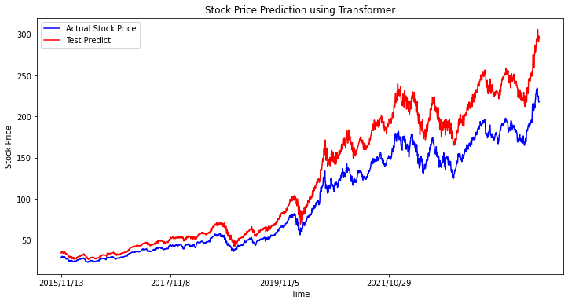
Experiments(39/42)
Predictive performance on datasets using the proposed model(AAPL)

Slide 77
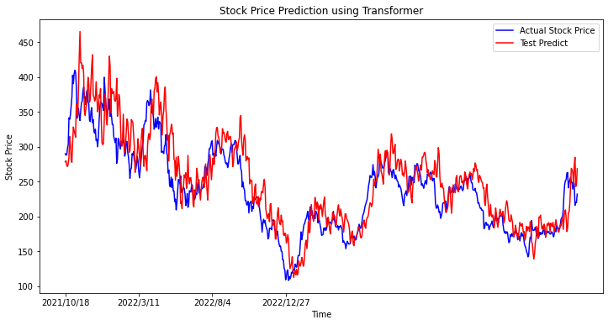
Experiments(40/42)
Predictive performance on datasets using the proposed model(TSLA)

Slide 78
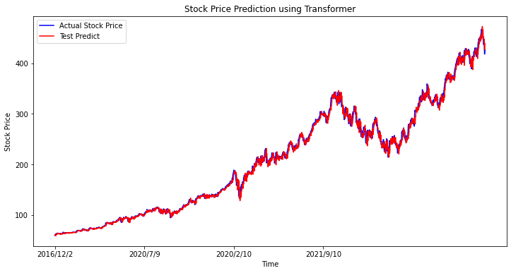
Experiments(41/42)
Predictive performance on datasets using the proposed model(MSFT)

Slide 79
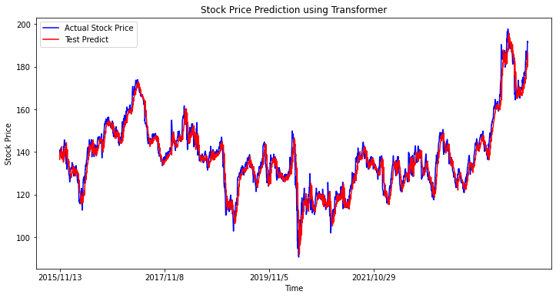
Experiments(42/42)
Predictive performance on datasets using the proposed model(IBM)

Slide 80
Conclusion

Slide 81
Conclusions
Constructed a new dataset combining quarterly and monthly financial ratios.
Compare with other modules shows our model has better
result.
Use our model with financial ratios to predict future stock prices of new stocks.
Notes:
Finally we make a conclusion.In this paper, We built a new dataset for stock price prediction and use our model LSTM(10,50) plus attention has great performance in two datasets compare with other six methods.

Slide 82
Conclusions
Constructed a new dataset combining quarterly and monthly financial ratios.
Compare with other modules shows our model has better
result.
Use our model with financial ratios to predict future stock prices of new stocks.
Notes:
Finally we make a conclusion.In this paper, We built a new dataset for stock price prediction and use our model LSTM(10,50) plus attention has great performance in two datasets compare with other six methods.

Slide 83
Future Work
There are relatively few studies on mixed frequency data
Improve the accuracy of our model.
Source code
https://github.com/freshpatrick/thesiscode.

Slide 84
References(1/2)
[1] A. Deep, “A multifactor analysis model for stock market prediction,” International Journal of
Computer Science and Telecommunications, vol. 14, no. 1, 2023.
[2]S. Mokhtari, K. K. Yen, and J. Liu, “Effectiveness of artificial intelligence in stock market
prediction based on machine learning,” arXiv preprint arXiv:2107.01031, 2021.
[3]Shi, Zhuangwei, et al. "Attention-based CNN-LSTM and XGBoost hybrid model for stock prediction." arXiv preprint
arXiv:2204.02623 (2022).
[4]Aadhitya, A., et al. Predicting Stock Market time-series data using CNN-LSTM Neural Network model. No. 2305.14378. 2023.
[5]Lin, H., et al. "Stock price prediction using generative adversarial networks." Journal of Computer Science 17.3 (2021): 188-196.

Slide 85
References(2/2)
[6] Lin, H., et al. "Stock price prediction using generative adversarial networks." Journal of Computer Science 17.3 (2021): 188-196.
[7] Aadhitya, A., et al. Predicting Stock Market time-series data using CNN-LSTM Neural Network model. No. 2305.14378. 2023.
[8] Wang, Shuzhen. "A stock price prediction method based on BiLSTM and improved transformer." IEEE Access (2023).

Slide 86
Thanks for listening

